Slide 1
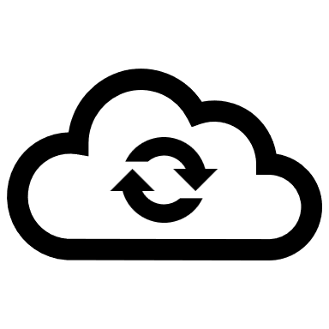



CLOUD SECURITY: CHALLENGES AND SOLUTIONS
Prathamesh Dhananjay Kulkarni

Slide 2
How does the Cloud work?
What are the Cloud models?
What is Cloud?
Is it safe?
Why is Cloud so popular?
What are the security challenges and solutions?
Are there any preventive measures?

Slide 3
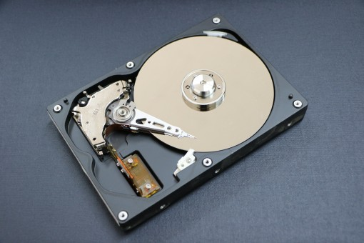
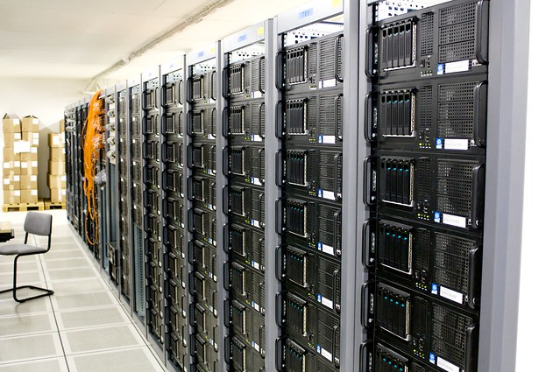
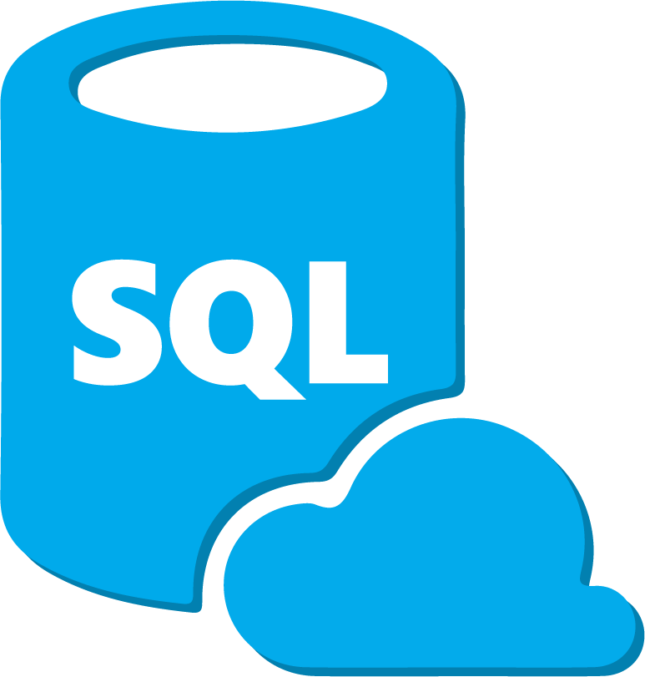
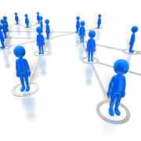
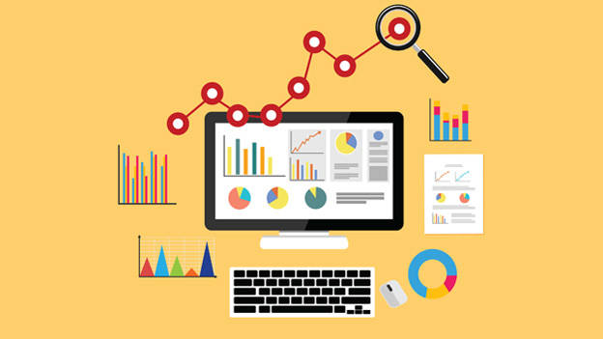
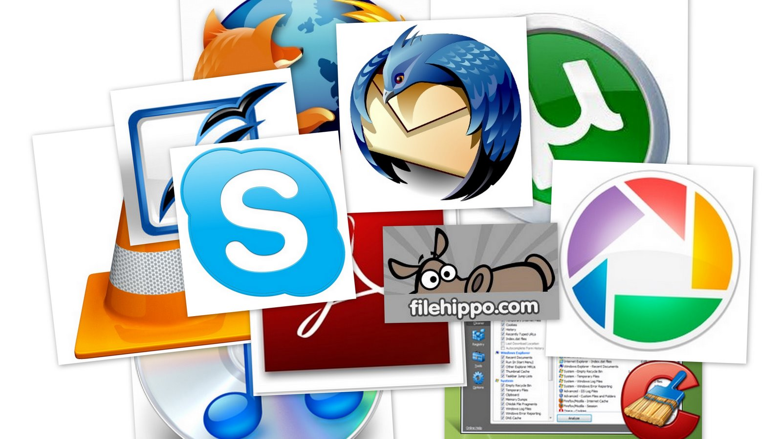
What Is Cloud?
Cloud computing is the delivery of shared computing services—including servers, storage, databases, networking, software, analytics, and intelligence- over the Internet (“the cloud”) to offer faster innovation, flexible resources, and economies of scale

Slide 4
Two types of cloud models
Cloud Service Model (SaaS, PaaS, IaaS)
Cloud Deployment Model (Private, Public, Hybrid, Community)

Slide 5
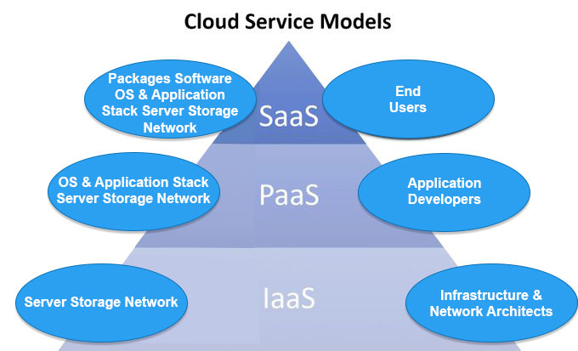
Cloud Service Model
Software as a Service (SaaS)
Platform as a Service (PaaS)
Infrastructure as a Service (IaaS)

Slide 6
Cloud Service Model
Software as a Service (SaaS) | Platform as a Service (PaaS) | Infrastructure as a Service (IaaS)
Direct access to third-party applications, software, OS is given to the end user through the client’s browser without any downloads or installations | Provides programming language execution environment, an operating system, a web server & a database for the development and deployment of applications and tools | Provides users with basic computer infrastructure capabilities like data storage, servers, and hardware
Example: Gmail | Example: Google App Engine | Example: Amazon EC2

Slide 7
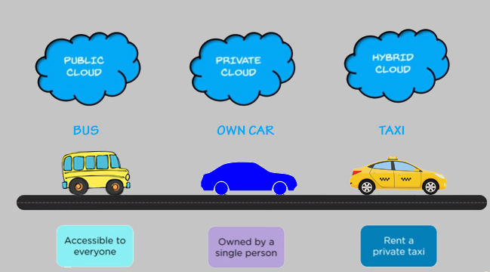
Cloud Deployment Model
Public Cloud
Private Cloud
Hybrid Cloud
Community Cloud

Slide 8
Cloud Deployment Model
Public Cloud – Publicly available, multiple tenants
Private Cloud – Dedicated for organizations
Hybrid Cloud – Combination of Public and Private Clouds
Community Cloud – Tailored for particular groups of customers

Slide 9
Characteristics Of Cloud Computing
On-demand self-service
Resource Pooling
Broad Network Access
Measured Service
Rapid Elasticity

Slide 10
Characteristics Of Cloud Computing
On-demand self-service – No human interaction needed with the CP
Resource pooling – IT resources pooled/grouped using multi-tenant model
Broad network access – Accessible over heterogenous devices and networks
Rapid elasticity – Scale in and scale out rapidly
Measured service – Keep track of resources used

Slide 11


Cloud Security: 5 Main Challenges
Massive Data and Intense Computation
Traditional security mechanisms are not sufficient
Example – Impractical to hash entire dataset to verify data integrity
Data
Data

Slide 12
Cloud Security: 5 Main Challenges
Shared Resource
Client 1
Imposter
Client 3
Client 2
2. Multi-tenancy
Resources shared by multiple customers
Data of multiple users reside on same machines
Creates issues like data breach, computation breach
Security risk from unknown peers

Slide 13


Cloud Security: 5 Main Challenges
3. Outsourcing
Customers physically lose control on their data and tasks
No knowledge or control over data
Loss of control over confidential data is root cause of cloud insecurity
No

Slide 14

Cloud Security: 5 Main Challenges
4. Data Storage Risk
Data is stored in centralized storages with peer data
Customers have no knowledge of the whereabouts of their own data
Your data is somewhere here!
(Probably)

Slide 15
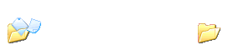
Cloud Security: 5 Main Challenges
5. Data Transmission Risk
Data transmission depends absolutely on the network in cloud storage mode
The threat of network attacks on data security is badly big
Hackers may intercept information, modify access rights, obtain or modify data while in transit
Hacker

Slide 16
Need For Security In Cloud
Dependence on cloud is analogous to dependence on public transportation
Forces one to trust over which one has no control, limits what one can transport, and subjects us to rules and schedules that wouldn’t apply if one had their own vehicles
But so economical that one doesn’t realistically have any alternative
Users rely completely on CPs for exercising appropriate security measures
Therefore, cloud security issue is one of the most important topics today in IT industry

Slide 17
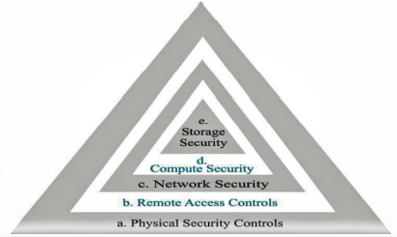
Security Framework
Physical Security (Perimeter Security)
Authentication (Access Control)
Network Security (Firewall)
Compute Security (Anti-virus)
Storage Security (Encryption)

Slide 18
Security Framework: 5 Layers
Physical Security (Perimeter Security): Physical devices should be secured
Authentication (Access Control): Identification of User should be done with access control
Network Security (Firewall): Going to observe inbound and outbound traffic.
Computer Security (Antivirus): The software antivirus is used to protect from malicious content
Storage Security (Encryption): The data should be encrypting with some algorithm

Slide 19
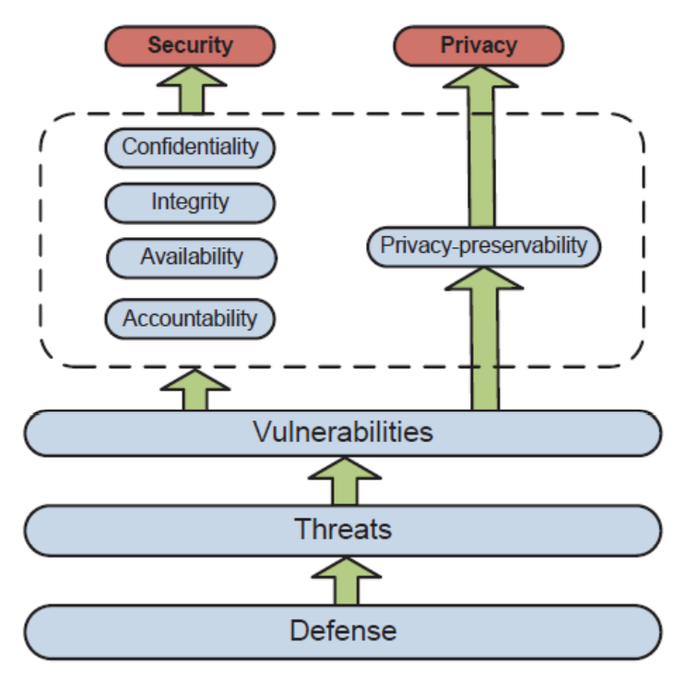
Security And Privacy Attributes
Five most representative security and privacy attributes are
Confidentiality
Integrity
Availability
Accountability
Privacy-preservability

Slide 20
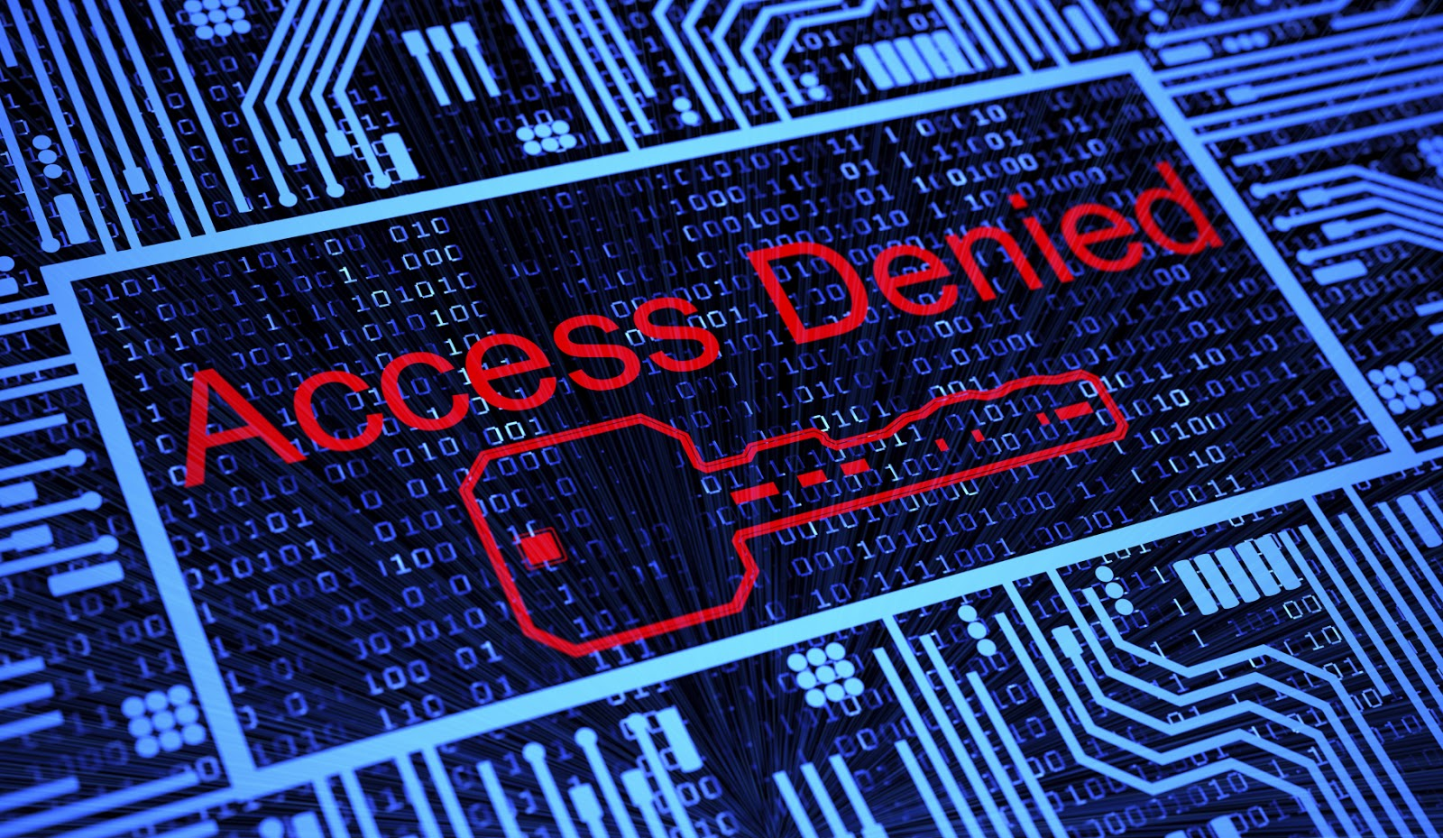
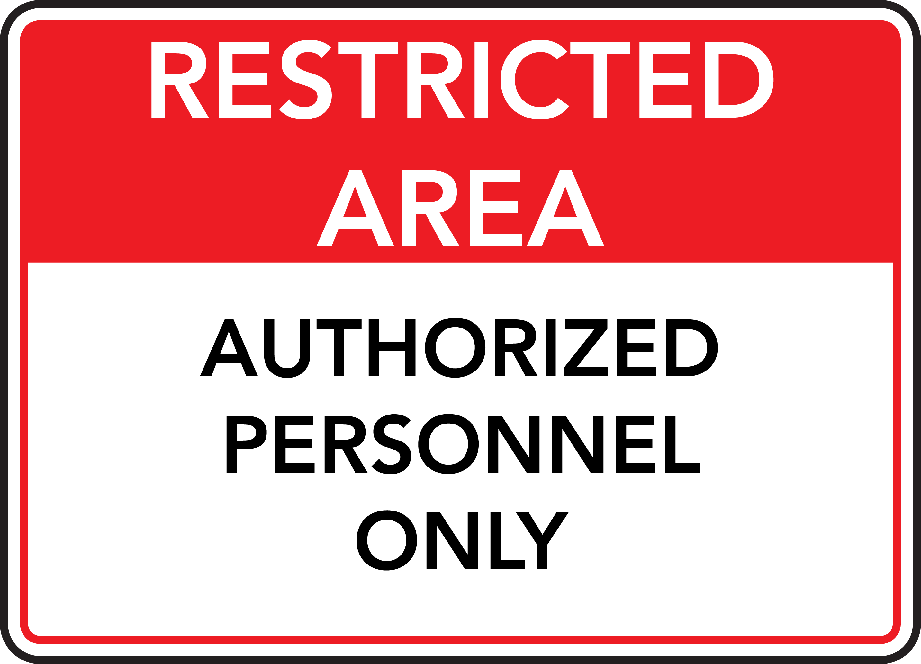
Cloud Confidentiality
Confidentiality is defined as the assurance that sensitive information is not disclosed to unauthorized persons, processes, or devices. i.e., customers data and computation tasks are to be kept confidential from both the cloud provider and other customers

Slide 21
Cloud Confidentiality: Threats
Cross-Virtual Machine (VM) attack via Side Channels
Exploits the nature of multi-tenancy
Malicious customers are able to steal data from other ones without leaving a trail
Malicious sysadmin
Privileged sysadmin of the cloud provider can perform attacks by accessing the memory of a customer’s VMs

Slide 22
Cloud Confidentiality: Defence Strategies
Trusted Cloud Computing Platform (TCCP)
Enables customers to determine if the service is secure before their VMs are launched into the cloud
Sysadmin with root privileges is unable to access the memory of a VM hosted in a physical node
NoHype
Minimizes degree of shared infrastructure by removing hypervisor
One core per VM feature prevents interference between VMs, eliminates side channels and retains multi-tenancy

Slide 23
Cloud Integrity
Computation integrity implies the notion that programs are executed without being distorted by malware, cloud providers, or other malicious users, and that any incorrect computing will be detected
Data integrity implies that data should be honestly stored on cloud servers, and any violations (e.g., data is lost, altered, or compromised) are to be detected

Slide 24
Cloud Integrity: Threats
Data loss/manipulation
Administration errors may cause data loss (e.g., backup and restore, data migration, and changing memberships in P2P systems)
Adversaries may initiate attacks by taking advantage of data owners’ loss of control over their own data
Dishonest computation in remote servers
Cloud servers may behave unfaithfully and return incorrect computing results
Problems may arise when a cloud server uses outdated, vulnerable code, has misconfigured policies, or has been previously attacked with a rootkit, triggered by malicious code or data

Slide 25
Cloud Integrity: Defence Strategies
Third Party Auditor (TPA)
Task of integrity checking is given to a third party which can be trusted by both cloud provider and customers
Ensures that cloud data can be efficiently audited without a local data copy, and cloud clients suffer no on-line overhead for auditing
Combating Dishonest Computing by Replication
Assigns one computation task to multiple machines, and then compares the results
Majority voting may be employed to determine correctness

Slide 26
Cloud Availability
If a certain service is no longer available or the quality of service cannot meet the Service Level Agreement (SLA), customers may lose faith in the cloud system
Availability is crucial since the core function of cloud computing is to provide on-demand service of different levels
For any information system to be useful, it must be available when needed

Slide 27
Cloud Availability: Threats
Flooding attack via Bandwidth Starvation
Huge number of nonsensical requests are sent to a particular service to hinder it from working properly
Direct DOS the attacking target is determined and Indirect DOS, all services hosted in the same physical machine with the target victim will be affected
Fraudulent Resource Consumption (FRC) attack
The attackers, continuously send requests to website hosting in cloud servers to consume bandwidth, which bills to the cloud customer owning the website
A FRC attack succeeds when it causes financial burden on the victim

Slide 28
Cloud Availability: Defence Strategies
Defending the new DOS attack
Monitoring agent located outside the cloud is set up to detect whether there may be bandwidth starvation by constantly probing the cloud applications
If bandwidth degradation is detected, the monitoring agent will perform application migration, which may stop the service temporarily
FRC attack detection
Key of FRC detection is to distinguish FRC traffic from normal activity traffic
Three detection metrics are used: Zipf ’s law, Spearman’s footrule and overlap between the reference list and the comparator list

Slide 29
Measures For Top Identified Threats
In case of Shared Technology issues
• Best Security practices must be implemented for installation or System configuration
• Unauthorized activities must be monitored
• Service level agreements must be enforced
• Configuration audits and vulnerability scanning must be conducted
• Strong authentication and access control administrative access

Slide 30
Measures For Top Identified Threats
For Data loss or Leakage
• Implement strong API access control
• Specify backup and retention mechanisms
• Analyze data protection at both design and run time
• Necessary measures must be taken for strong key generation, storage, and destruction practices

Slide 31
Measures For Top Identified Threats
For Malicious Insiders
• Identify the human resources requirements as a part of legal contracts
• Information security, management practices require transparency
• Decide Security breaches
• Conduct survey on comprehensive supplier assessment and implement strict supply chain management

Slide 32
Measures For Top Identified Threats
With respect to Account or Service Hijacking
• Strong monitory system implementation for to detect unauthorized activity
• Sharing of account details between users and services must be avoided
• Read and understand properly cloud security policies

